Slide 1
Process
Process concept

Slide 2
Process- in brief
A batch system executes jobs, whereas a time-shared system has user programs, or tasks. Even on a single-user system, a user may be able to run several programs at one time: a word processor, a Web browser, and an e-mail package. And even if a user can execute only one program at a time, such as on an embedded device that does not support multitasking, the operating system may need to support its own internal programmed activities, such as memory management. They are known as processes
Process – program in execution

Slide 3
The Process
A process is more than the program code, which is sometimes known as the text section.
It also includes the current activity, as represented by the value of the program counter and the contents of the processor’s registers.
A process generally also includes the process stack, which contains temporary data (such as function parameters, return addresses, and local variables), and a data section, which contains global variables .
A process may also include a heap , which is memory that is dynamically allocated during process run time.
A program is a passive entity, such as a file containing a list of instructions stored on disk. a process is an active entity, with a program counter specifying the next instruction to execute and a set of associated resources.
A program becomes a process when an executable file is loaded into memory.

Slide 4
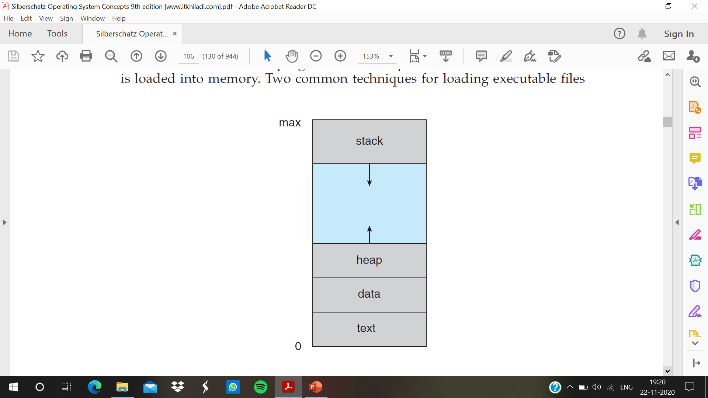
Process In Memory

Slide 5
Process State
As a process executes, it changes state. The state of a process is defined in part by the current activity of that process. A process may be in one of the following states:
• New-The process is being created.
• Running-Instructions are being executed.
• Waiting-The process is waiting for some event to occur (such as an I/O completion or reception of a signal).
• Ready-The process is waiting to be assigned to a processor.
• Terminated-The process has finished execution

Slide 6
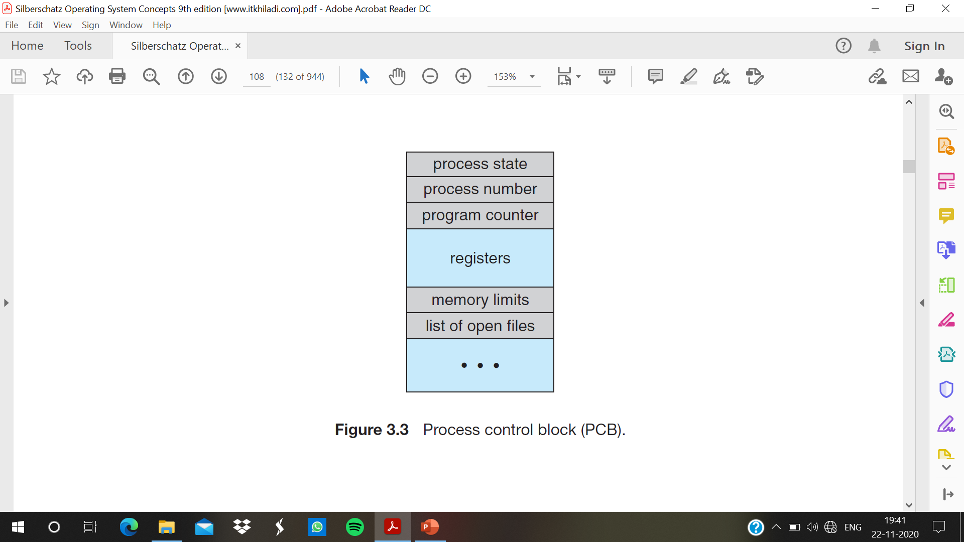
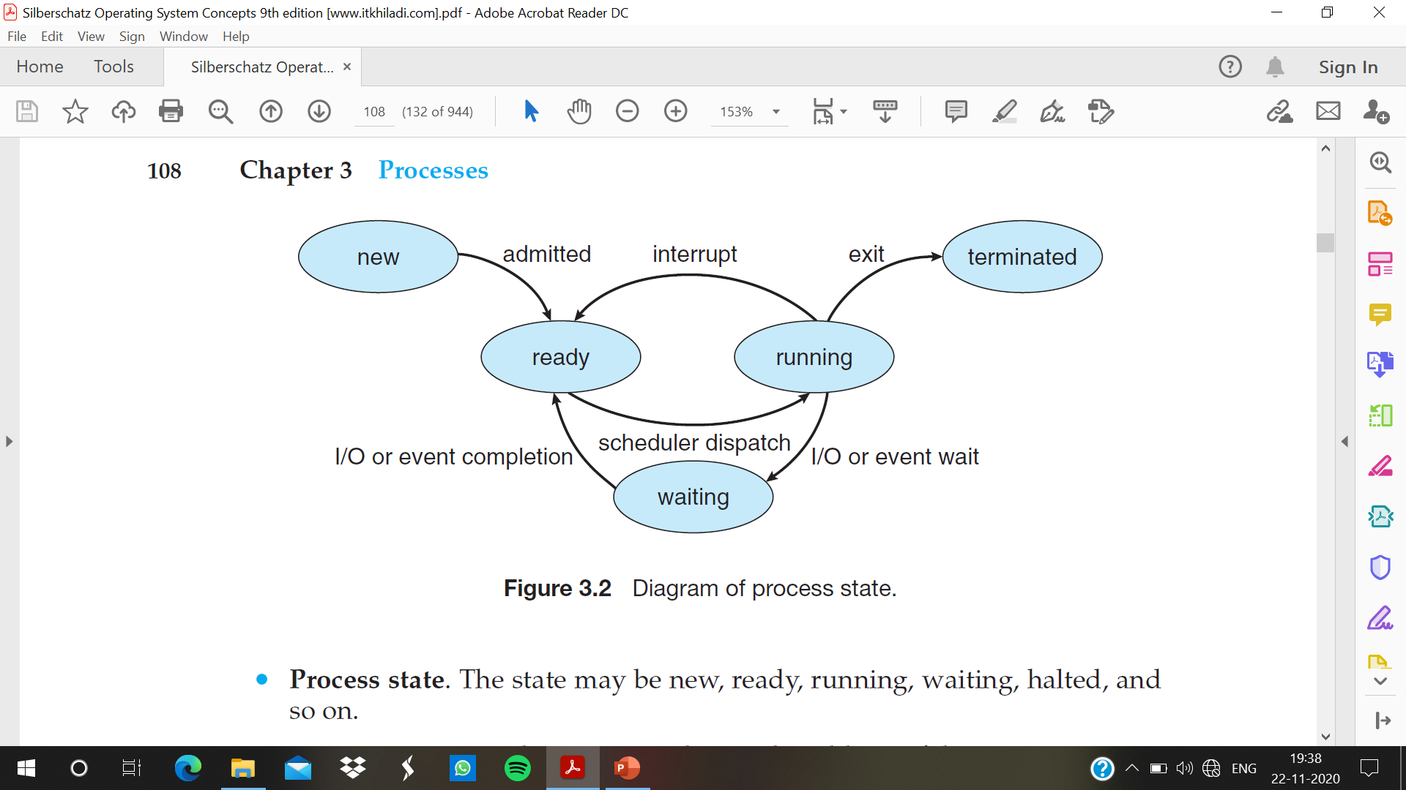
Process Control Block
Each process is represented in the operating system by a process control block (PCB)—also called a task control block.

Slide 7
It contains many pieces of information associated with a specific process, including these:
• Process state. The state may be new, ready, running, waiting, halted, and so on.
• Program counter. The counter indicates the address of the next instruction to be executed for this process.
• CPU registers. The registers vary in number and type, depending on the computer architecture. They include accumulators, index registers, stack pointers, and general-purpose registers, plus any condition-code information. Along with the program counter, this state information must be saved when an interrupt occurs, to allow the process to be continued correctly afterward.

Slide 8
• CPU-scheduling information. This information includes a process priority, pointers to scheduling queues, and any other scheduling parameters.
• Memory-management information. This information may include such items as the value of the base and limit registers and the page tables, or the segment tables, depending on the memory system used by the operating system
• Accounting information. This information includes the amount of CPU and real time used, time limits, account numbers, job or process numbers, and so on.
• I/O status information. This information includes the list of I/O devices allocated to the process, a list of open files, and so on.

Slide 9
Threads
a process is a program that performs a single thread of execution.
single thread control allows the process to perform only one task at a time.
multiple threads of execution perform more than one task at a time.

